Slide 1
Graphene
Eric Elsner
April 13th 2020

Slide 2
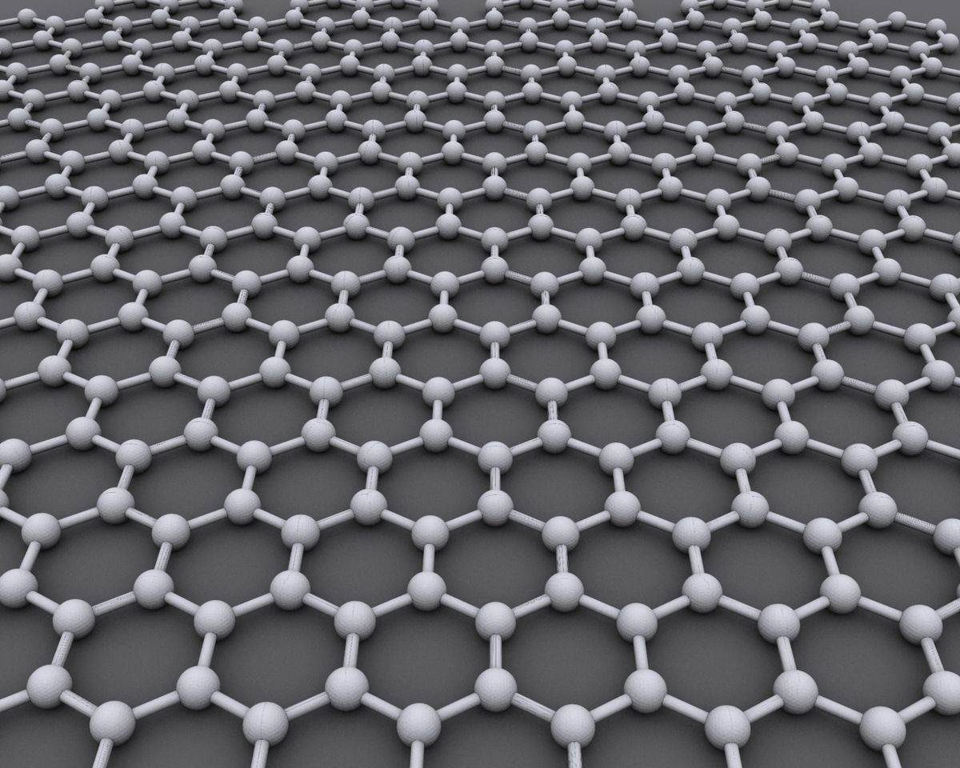
Overview
Graphene theory
How graphene theory and graphene applies to devices
The application of graphene in displays
https://upload.wikimedia.org/wikipedia/commons/thumb/9/9e/Graphen.jpg/1200px-Graphen.jpg

Slide 3
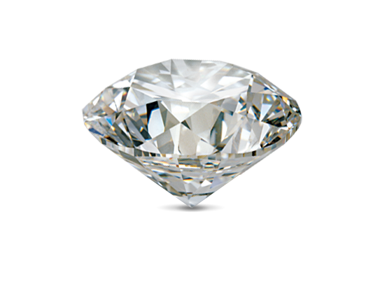
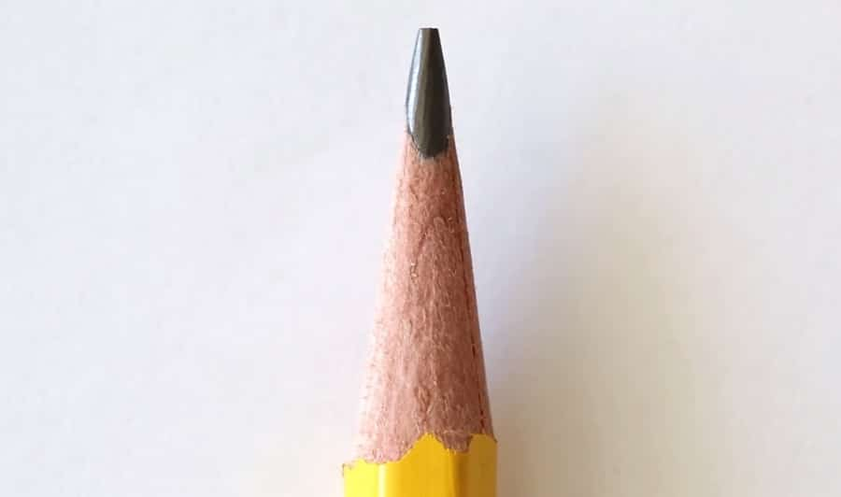
What is Graphene?
https://img.digitaltrends.com/image/graphene-structure-640x640.png
Simple answer:
the material used in pencil lead
Single, thin layer of graphite
Complex answer:
Element of carbon, posses the same atoms just arranged in a different way
Graphite and diamonds are both forms of carbon, yet have wildly different natures and applications.
https://thekidshouldseethis.com/wp-content/uploads/2016/10/pencil-lead-00.jpg

Slide 4
Desired Graphene Properties
Electrical
Graphene is a zero-overlap semimetal with both holes and electrons as charge carriers
Giving it extremely high electrical conductivity
Mechanical
Extreme Strength (0.142 Nm-long carbon bonds)
130,000,000,000 pascals, compared to steels 400,000,000 pascals
Elastic properties
Extremely light
Optical
Absorbs 2.3% of white light

Slide 5
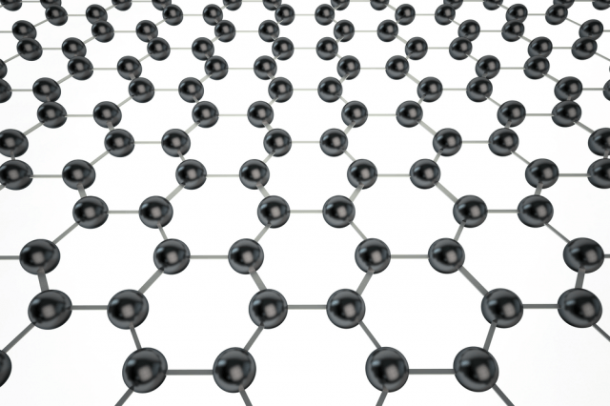
Graphene Theory
Graphene is a single layer of carbon atoms tightly packed into a two-dimensional honeycomb lattice. Graphene is part of the family of atomic "nano-carbons" that includes carbon nanotubes and buckeyballs (C60 fullerenes), and is a single or a few atomic layers of the three-dimensional material graphite. Graphene is being most widely studied for its remarkable electronic transport properties at room temperature for ballistic transistors and other high-speed electronic components; its optical properties for solar photovoltaics; and its high surface area for ultracapacitors. Graphene has also been suggested as a potential material for use in quantum computing and spintronics.
https://img.digitaltrends.com/image/graphene-structure-640x640.png

Slide 6
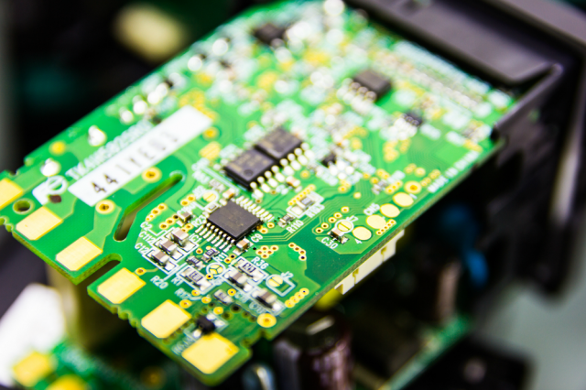
Semiconductors
High conductivity, allows for increased information travel speed
Electricity conducts much faster when placed a top of graphene instead of silicon
Biggest obstacle of graphene is the lack of band gap
The gap between valence and conduction bands in the material
Research is being done daily improving the applications of graphene in semiconductors. Graphene is cutting edge and we are simple at the tip of the iceberg
https://img.digitaltrends.com/image/semiconductor-example-640x640.png

Slide 7
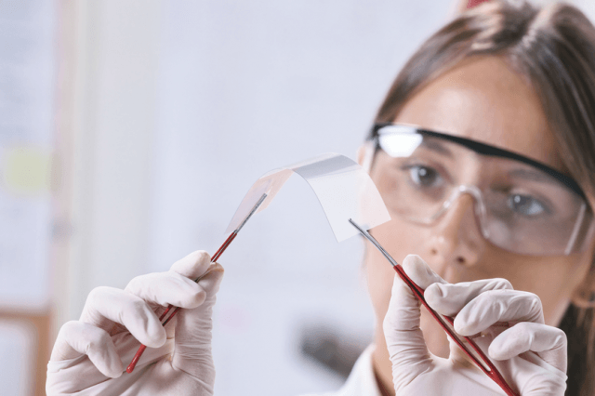
Flexible Electronics
https://img.digitaltrends.com/image/grapheneflexible-640x640.png
Graphene is highly flexible
Allow application in smartphone and tablet
Giving durability alone with flex properties
Flexible jewellery is becoming popular
Design possibility of fitting snug with the desired body part
Microscopic opportunities
Small machines and sensor built using graphene could navigate the human body
Our bodies already have carbon approximately 18.6%

Slide 8
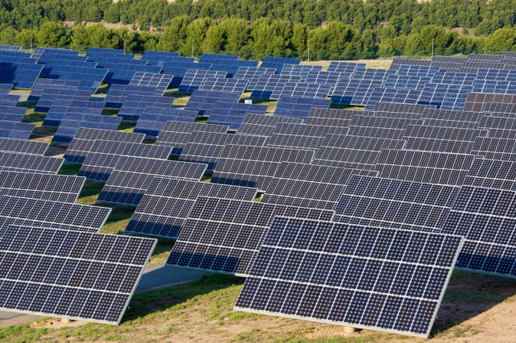
Solar cells/photovoltaics
Highly conductive and transparent
Typically use silicon
Silicon release one electron per photon hit
Converting to graphene
Releases multiple electrons for each photon hit
Since graphene is relatively new we are At the tip of the iceberg and could see huge surges in renewable energy due to graphene
https://img.digitaltrends.com/image/solarpanelsexample-640x640.jpg

Slide 9
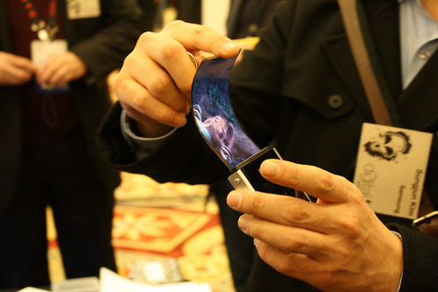
Display Application
Current tablets and smartphones use indium tin oxide
Not flexible and expensive
Graphene would create a flexible durable screen
Causing broken screens to be a thing of the past
http://www.graphene-uses.com/wp-content/uploads/2015/08/Graphene-flexible-OLED-and-AMOLED-display-will-come-soon-in-many-mobiles-.jpg

Slide 10
Graphene Display
Screens eat up battery, our current screens are extremely inefficient
Reflective-type Display
E-book readers
Graphene is the key to tougher and more flexible OLED displays
LG invested 1.75 billion into OLED development
Possible future application is displays woven into clothing that is able to withstand the elements

Slide 11
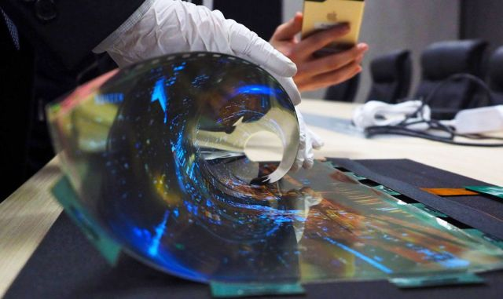
https://o.aolcdn.com/images/dims?thumbnail=640%2C&quality=80&image_uri=https%3A%2F%2Fs.yimg.com%2Fuu%2Fapi%2Fres%2F1.2%2FRJ5Vg22CxPJv1_jFAy28aw--%7EB%2Fdz0xNDMyO2g9ODUzO2FwcGlkPXl0YWNoeW9u%2Fhttps%3A%2F%2Fo.aolcdn.com%2Fhss%2Fstorage%2Fmidas%2Fa94e5116336073445c10ee08da4893ee%2F205152857%2Foledflexi-main-dl.jpg&client=amp-blogside-v2&signature=8134b573ddfcc4b3d9b9d18c8bc6c34be098f553

Slide 12
The Future
The endless strengths of graphene show great promise but….
It’s extremely expensive
Risks of tiny fissures or other flaws in the material when produced
The research on graphene is by no means slowing down, programs and patents are popping up around the world trying to be the company on the crest of the wave of graphene

Slide 13
References
http://www.issp.ac.ru/ebooks/books/open/Graphene_-_Synthesis__Characterization__Properties_and_Applications.pdf
https://www.mri.psu.edu/mri/research-capabilities/traditional-research/electronic-materials-devices/graphene-theory
https://slate.com/news-and-politics/2009/08/are-you-heating-the-planet-when-you-breathe.html
https://www.digitaltrends.com/cool-tech/9-amazing-graphene-applications/
https://www.digitaltrends.com/cool-tech/what-is-graphene/
https://www.graphenea.com/pages/graphene-properties#.XpE6PPhKhPY
http://www.graphene-uses.com/graphene-build-flexible-screen/
https://phys.org/news/2018-11-graphene-flickers-400hz-2500ppi.html

Slide 14
Key Points
Graphene is carbon, same as pencil lead or a diamond
Graphene is a single atom honeycomb structure
Graphene has very desirable electrical, mechanical, and optical properties
Could be the next big breakthrough in renewable energy
Discovered in 1859, scientific research exploded in 2003

